Slide 1
Welcome
To Our
QUIZ
NIGHT
Get your answer sheet from the host to join in.

Slide 2
Round 1
Common Knowledge
Not So
1) From what part of the ginger plant do you enjoy the spicy taste of ginger?
2) What movie follows the ins and outs of Lester Burnham's mid-life crisis?
3) A Cumulonimbus, from the Latin cumulus and nimbus is a type of what?
4) What is Charlie's nephew's name on the TV show "Two and a Half Men"?
Did you know – Shakespeare invented over 1700 of our common words.

Slide 3
Round 1
Common Knowledge
Not So
5) What is the three-letter IATA code for London Heathrow airport?
6) Ian Gillan, Ian Paice, Roger Glover and Steve Morse formed which rock band?
7) Fitzroy Crossing is a small town in which Australian state?
8) What layer of the Earth's atmosphere sits between the troposphere and mesosphere?
Did you know – Shakespeare invented over 1700 of our common words.

Slide 4
Round 1
Common Knowledge
Not So
9) What name does Victoria's Secret give to their models?
10) Fox Mulder is a highly skilled FBI Special Agent in which fictional television series?
11) Which volcano caused the devastating destruction of Pompeii?
12) Omaha is a variation of which other popular card game?
Did you know – Shakespeare invented over 1700 of our common words.

Slide 5
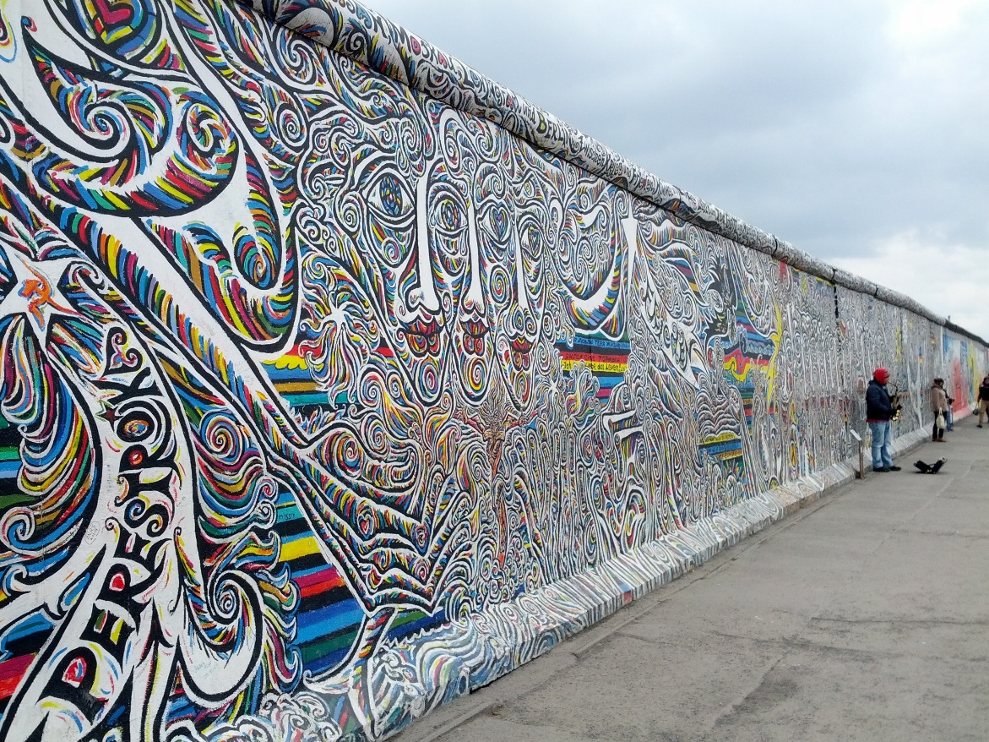
BONUS QUESTION!
Q) In kilometres, what was the total length of the Berlin Wall?

Slide 6
Round 2.
Who, What, Where??
1) What is the name of a brimmed straw hat as well as the name of a popular canal?
2) What do you call a person who does not believe in the existence of God or gods?
3) Muammar Gaddafi is the former disgraced Prime Minister of which country?
4) Part of the Great Dividing Range, what is the highest mountain in Victoria?
Did you know – In military terms, a "klick" means a distance of 1000 meters

Slide 7
Round 2.
Who, What, Where??
5) What is the capital of New Zealand?
6) "Hasta la vista baby" is the famous line from which Terminator movie?
7) Plus or minus 5 million, what is the estimated population of the United States according to the US Census Bureau?
8) Clive Owen, Mel Ferrer, Nigel Terry and Sean Connery have all played which role in film?
Did you know – In military terms, a "klick" means a distance of 1000 meters

Slide 8
Round 2.
Who, What, Where??
9) Prozac took the world by storm as a drug treatment for what?
10) Who assassinated John Lennon?
11) In snooker, the maximum break under normal circumstances is what?
12) The Cayman Islands, a British Overseas Territory, encompasses 3 islands in what sea?
Did you know – In military terms, a "klick" means a distance of 1000 meters

Slide 9
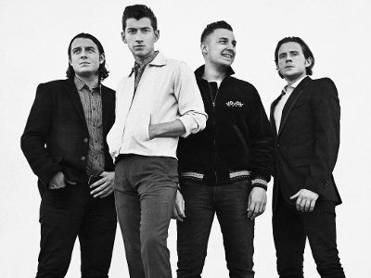
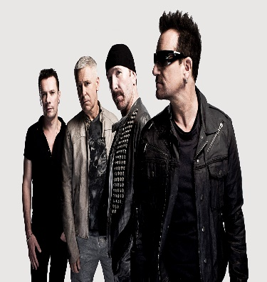
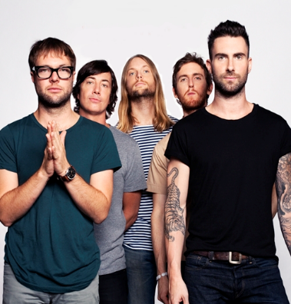
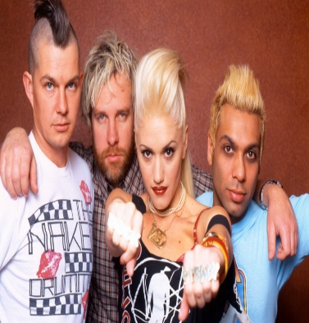
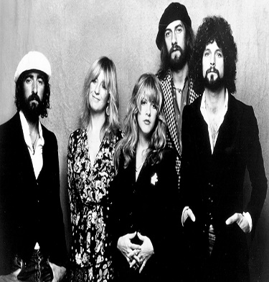
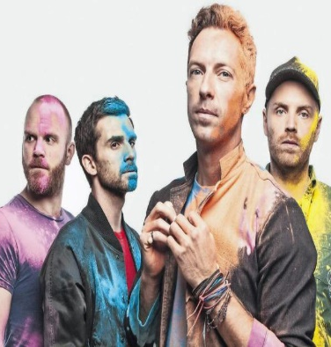
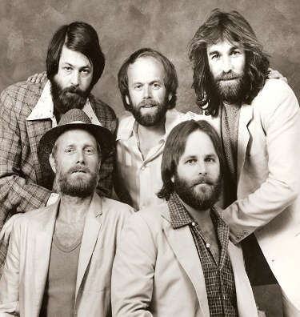
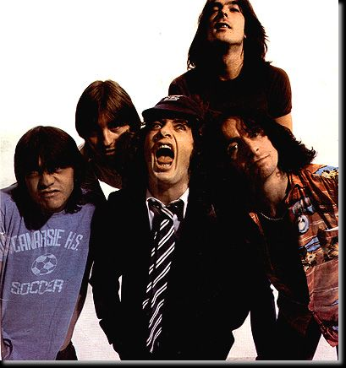
Name The Band
1.__________
2.__________
3.__________
4.__________
5.__________
6.__________
7.__________
8.__________
9.__________
10._________
Team Name._____________________

Slide 10
Round 3 - WTF
What The Flip
1) Name the 3 movies in which Brad Pitt plays a role that has the number 12 in the film title?
2) The martini is a cocktail made with gin and what other main ingredient.
3) What city is home to the Telstra Tower?
4) The biblical figures Melchior, Caspar and Balthasar are more often refered to as what?
Did you know – Philadelphia was once the capital of the United States.

Slide 11
Round 3 - WTF
What The Flip
5) What are the young of seals called?
6) Which two US states begin with the letter "V"?
7) What is an uncastrated, adult male horse called?
8) Name the seventh planet from the sun.
Did you know – Philadelphia was once the capital of the United States.

Slide 12
Round 3 - WTF
What The Flip
9) What kind of weapon is a falchion?
10) Which kind of bulbs were once exchanged as a form of currency?
11) Who played the role of Mork in the TV show Mork and Mindy?
12) What male tennis player has won the most Grand Slam titles?
Did you know – Philadelphia was once the capital of the United States.

Slide 13
Pick the Songs.
Name the Song & Band.
(Click Box to play)

Slide 14
Round 4
The Lucky Dip
1) What Scottish city is the setting for "Trainspotting"?
2) In what country did the Hindenburg airship disaster occur?
3) A Wobbegong is a species of which animal?
4) What is the name of the instrument used for listening to the heart?
Did you know – A light year is equal to 10 trillion kilometres

Slide 15
Round 4
The Lucky Dip
5) What movie concerns the search for One-Eyed Willie's pirate treasure?
6) If you had Lafite-Rothschild on your dinner table, what would it be?
7) Catalonia is a region of what country?
8) How many legs does a butterfly have?
Did you know – A light year is equal to 10 trillion kilometres

Slide 16
Round 4
The Lucky Dip
9) What branch of medicine deals with the prevention, diagnosis and treatment of cancer?
10) What is the medical term for low blood sugar?
11) What does the "N" stand for in NATO?
12) “I don’t believe in an interventionist god, but I know darling that you do" is the opening line to which song by whom?
Did you know – A light year is equal to 10 trillion kilometres

Slide 17
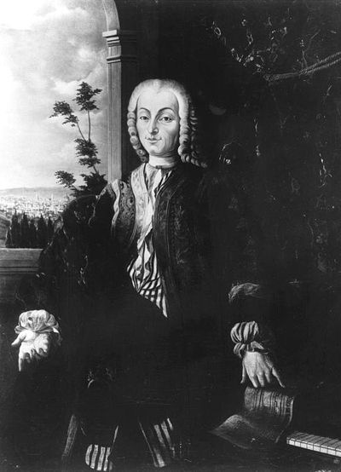
Jackpot Question!
Q) Who invented the piano?

Slide 18
TIE BREAKER
1) Whose daughter have The Eagles been searching for, in their #1 hit song "One of These Nights"?
2) What is the full name of writer H. G. Wells?
3) What year did the Cold War officially end?

Slide 19
Thanks for playing!
Book now for next week!

