Slide 1
TRIVIA NIGHT
Get your answer sheet from the host to join in.

Slide 2
Round 1.
1) What is the largest joint in the human body?
2) What is the name of the branch of medicine pertaining to the heart?

Slide 3
Round 1.
3) What American girl group had a 2001 hit with "Bootylicious"?
4) What childrens character had a friend called 'Boo Boo'?

Slide 4
Round 1.
5) The Japanese delicacy of fugu, poisonous if not prepared correctly, is made from what?
6) What was the first city to reach a population of one million?

Slide 5
Round 1.
7) Which TV series has episode titles starting with the words 'The One With' or 'The One Where'?
8) Which rap star became a TV legend, starred in "The Pursuit Of Happyness" and produced "The Secret Life Of Bees"?

Slide 6
Round 1.
9) Which country lies between Nicaragua and Panama?
10) Before being dried, which fruit was a prune?

Slide 7
Round 1.
11) What was the name of the German airship that caught fire while attempting to dock in New Jersey in 1937?
12) What does a 'misogynist' hate?

Slide 8
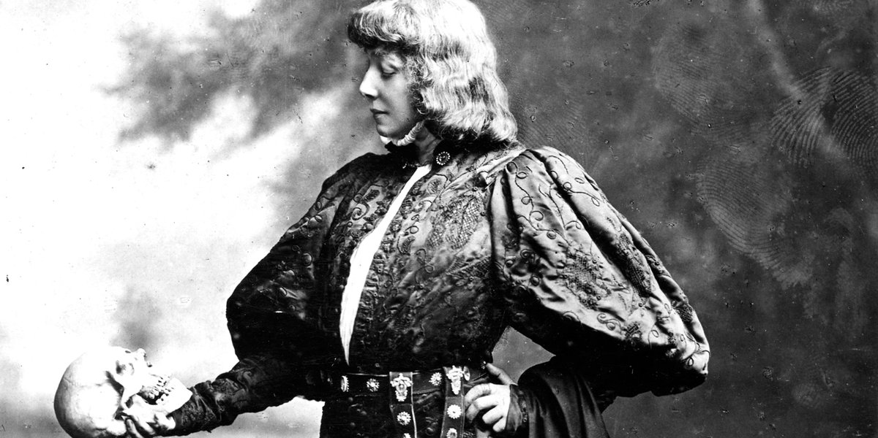
BONUS QUESTION.
Q) How many words does Shakespeare's longest play Hamlet have?

Slide 9
Round 2.
1) The practice of being married to only one person at a time is called what?
2) Mauritius is part of which continent?

Slide 10
Round 2.
3) What film trilogy sequels are named Reloaded and Revolutions?
4) What Shakespearean king was actually king of Scotland for 17 years?

Slide 11
Round 2.
5) Tom Cruise - 2 Pointer. In the 1980's, Tom Cruise starred in 2 movies that started with the letter "R". Can you name them?
6) On a bottle of Sunscreen, you see the letters SPF. What do the initials SPF stand for?

Slide 12
Round 2.
7) Name the 2 dwarfs from the Snow White fairytale whose names do not end in the letter 'Y"?
8) If you were making a Mai Tai cocktail, you mix which alcohol would you mix with lime juice, curacao liqueur and syrup?

Slide 13
Round 2.
9) The French phase "Répondez s'il vous plaît" is better known in English speaking countries as what?
10) Linseed is also known by what other name?

Slide 14
Round 2.
11) Which herbivorous dinosaur was known by it's two rows of bony plates along it's back, and it's bony spikes on the end of their tail?
12) The Federal leader of the Green party resigned recently after 5 years in the role. What is his name?

Slide 15
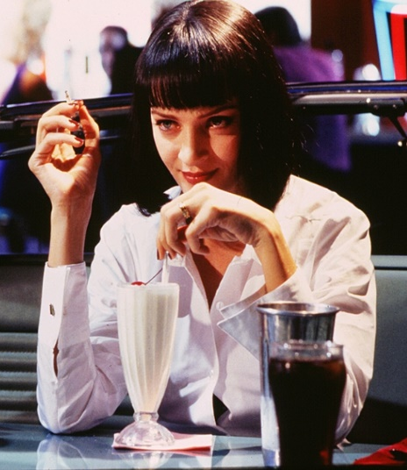
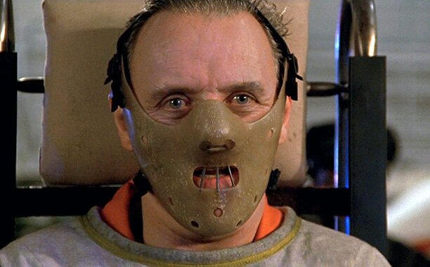
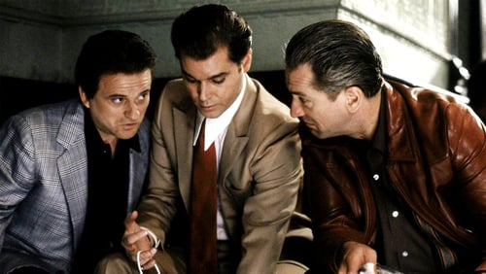
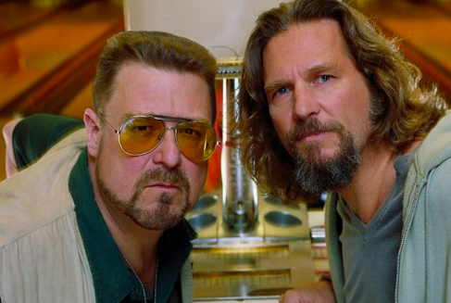
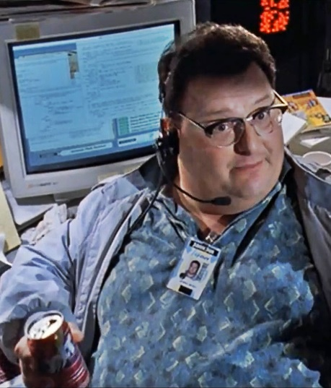
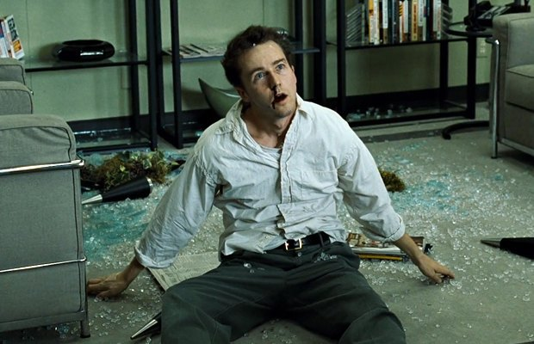
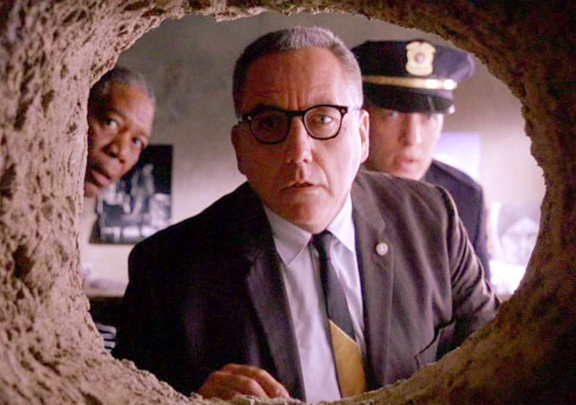
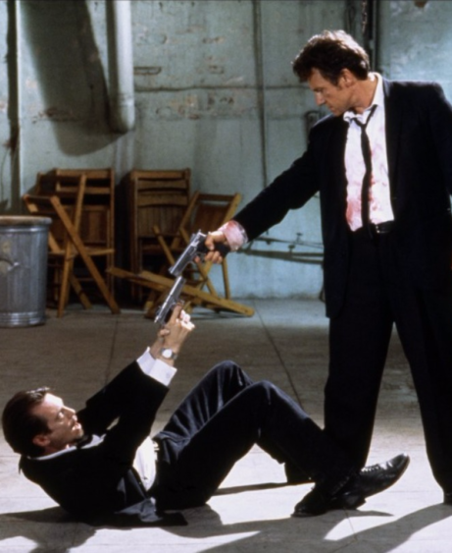
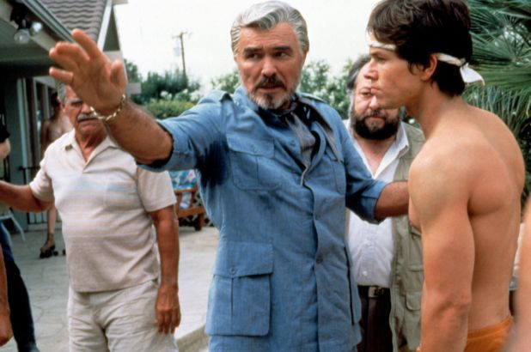
Best Movies of the 90’s
1.__________
2.__________
3.__________
4.__________
5.__________
6.__________
7.__________
8.__________
9.__________
10._________

Slide 16
True or False.
1) Laos was a former colony of Spain.
2) The sound of E.T. walking was made by someone squishing their hands in Jelly.

Slide 17
True or False.
3) After a Diamond, the next hardest stone found in nature is the sapphire.
4) Franklin D. Roosevelt coined the saying, "Do one thing every day that scares you."

Slide 18
True or False.
5) John Ratzenberger is a voice actor who has been a character in every single Pixar film.
6) In the average lifetime, a person will walk the equivalent of 15 times around the equator.

Slide 19
True or False.
7) According to suicide statistics, Sunday is the favored day for self-destruction.
8) Isaac Asimov holds the title of being the only author to have written at least one book for each dewey decimal class.

Slide 20
True or False.
9) Neanderthals had bigger brains than people of today.
10) Mirage is the collective name for a group of zebras .

Slide 21
Round 3.
1) Which Australian Sitcom was set in the fictional town of Fountain Lakes?
2) Where would you need to be to see Michelangelo's most famous ceiling paintings?

Slide 22
Round 3.
3) Where is the Sea of Tranquility?
4) Which southern German city is famous for its annual beer festival?

Slide 23
Round 3.
5) Who's law stated that 'For every action, there is an equal and opposite reaction'?
6) In what year did Michael Jackson die after taking a mixture of drugs?

Slide 24
Round 3.
7) Alfred E. Neuman is the fictitious mascot and cover boy of which American humor magazine?
8) In Catholicism, lent lasts how many days?

Slide 25
Round 3.
9) The American artist Spencer Tunick is best known for photographing large groups of people with what common theme?
10) Sharing its name with a Paris cabaret movie, what is the words for 'Red Windmill' in French?

Slide 26
Round 3.
11) Which Australian actor played the leading role in the 2009 acclaimed movie "Avatar"?
12) If someone is taking your axillary temperature, where have they put the thermometer?

Slide 27
Name the Songs & Artists
(Click picture to play)

Slide 28
Round 4.
1) Which song did Elton John famously perform at Princess Diana’s funeral?
2) What is the cube root of 1,000?

Slide 29
Round 4.
3) According to Stevie Wonder, where is the writing?
4) Suva is the capital of which country in Oceania?

Slide 30
Round 4.
5) What spin-off of Breaking Bad stars Bob Odenkirk as a lawyer?
6) In the Back to the Future movies, What was the first name of Marty's father?

Slide 31
Round 4.
7) What motorcycle company produces the Ninja ZX?
8) Who was famously found guilty of killing his girlfriend Riva Steinkamp?

Slide 32
Round 4.
9) Bagatelle No. 25, more commonly known as "Für Elise", is one of who's most popular piano compositions?
10) On a standard UK monopoly board, what colour is Leicester Square?

Slide 33
Round 4.
11) Famous for its battle in 1815, In which country is the town of Waterloo?
12) What tennis player did Novak Djokovic defeat to win his 8th Australian Open Singles title on February 2nd?

Slide 34
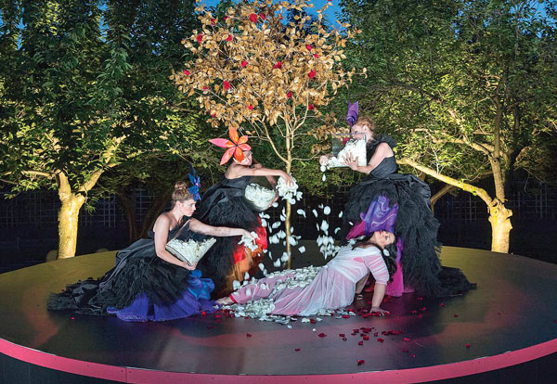
Jackpot Question!
Q) ’La hija de Rappaccini’ is an opera in two
acts composed by who?

Slide 35
TIE BREAKERs
1) In what year did Tom Cruise marry Nicole Kidman?
2) In what year did James Blunt release the song ' Your Beautiful"?
3) In what year did Whitney Houston release her song ‘I wanna dance with somebody'?

Slide 36
Thanks for playing!
Book now for next week!

